Slide 1



YOUR LOGO HERE
Climate Change Adaptation Plan – Workshop 3
Meeting XX
(Amend slides as applicable)


Slide 2

Time | Agenda
 | Introductions and Work so Far –
 | What are the outcomes of the current draft Action Plan? Understanding the layout and how current actions meet priority risks.
 | Group Exercise 1: Assess draft actions against priority climate risks Participants break up by service area to assess to what extent the draft actions listed for their service meet the risks from climate change identified in the previous workshop. 40 Minute exercise, 15 Minute feedback
 | 10 Minute Break
 | Group Exercise 2: Define Priority Actions Participants to: Sense-Check Draft Actions Identify priority actions and any missing actions for their service 35 Minute exercise, 15 Minute feedback
 | Next Steps and Call for Information The process for contributing further information and sign-off over the coming months
 | Close

Slide 3





What are the outcomes of the current draft Action Plan?

Slide 4
Group Exercise 1 - Assess draft actions against priority climate risks.

Slide 5

Group Exercise 1 - Assess draft actions against priority climate risks.
(40 minutes)
Participants break up by service area to assess to what extent the draft actions listed for their service meet the risks from climate change identified in the previous workshop.
Breakout Room 1: Chair – 1: Scribe – 1
Group 1 - You are to look at X Department(s) first
Breakout Room 2: Chair – 2: Scribe – 2
Group 2 - You are to look at X Department(s) first
Breakout Room 3: Chair – 3: Scribe – 3
Group 3 - You are to look at X Department(s) first

Slide 6
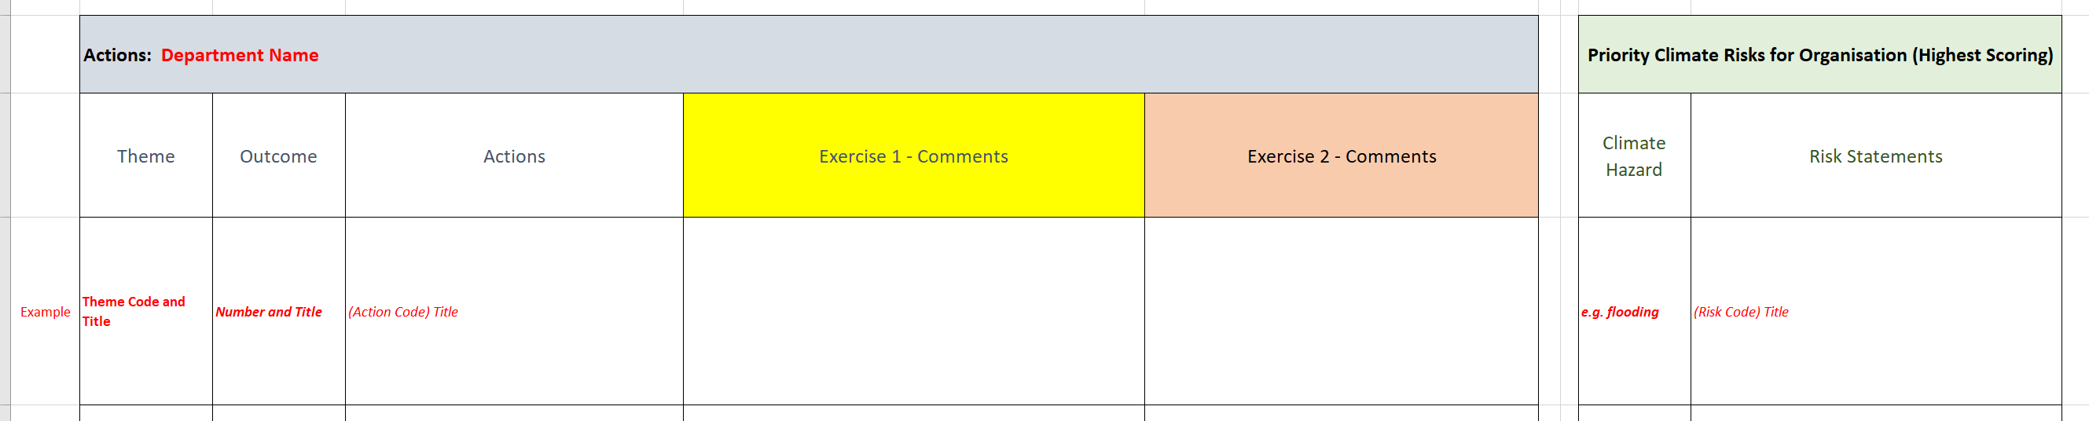
Group Exercise 1 - Assess draft actions against priority climate risks.
(40 minutes)
Participants break up by service area to assess to what extent the draft actions listed for their service meet the risks from climate change identified in the previous workshop.
Take a few moments at the beginning to familiarise yourself with the risk register.
Please explain how the action improves resilience in the comment box.

Slide 7

10 Minute Break

Slide 8
Group Exercise 2 - Define Priority Actions

Slide 9
Group Exercise 2 - Define Priority Actions
(35 minutes)
• Sense-Check Draft Actions
• Identify priority actions and any missing actions for your service
Breakout Room 1: Chair – 1: Scribe – 1
Group 1 - You are to look at X Department(s) first
Breakout Room 2: Chair – 2: Scribe – 2
Group 2 - You are to look at X Department(s) first
Breakout Room 3: Chair – 3: Scribe – 3
Group 3 - You are to look at X Department(s) first

Slide 10
Group Exercise 2 - Define Priority Actions
(35 minutes)
• Sense-Check Draft Actions
• Identify priority actions and any missing actions for your service
You don’t have to fill in every box. Just spend a few mins on assessing if there are any missing actions, and the majority of the session deciding which are the priority actions.

Slide 11
Next Steps and Call for Information

Slide 12
Next Steps and Call for Actions
Next Steps
One-to-One Meetings
Sign off Date

