Slide 1

Workshop 2 ----------------
Time | Agenda
13:00 | Workshop Introduction and Adaptation Planning Progress so Far -
13:10 | Group Exercise 1: Review and Feedback on Draft Risk Register 40 Minute exercise, 15 Minute feedback
14.05 | 10 Minute Break
14:15 | Presentation on Draft Vision and Aims –
14:25 | Presentation on Draft Themes –
14:35 | Group Exercise 2: Review and Feedback on Draft Vision, Aims and Themes 35 Minute exercise, 10 Minute feedback
15:20 | Next Steps and Call for Actions The process for contributing actions and information ahead of Workshop 3
15:30 | Close

Slide 2





Introduction and Adaptation Planning Progress So Far

Slide 3
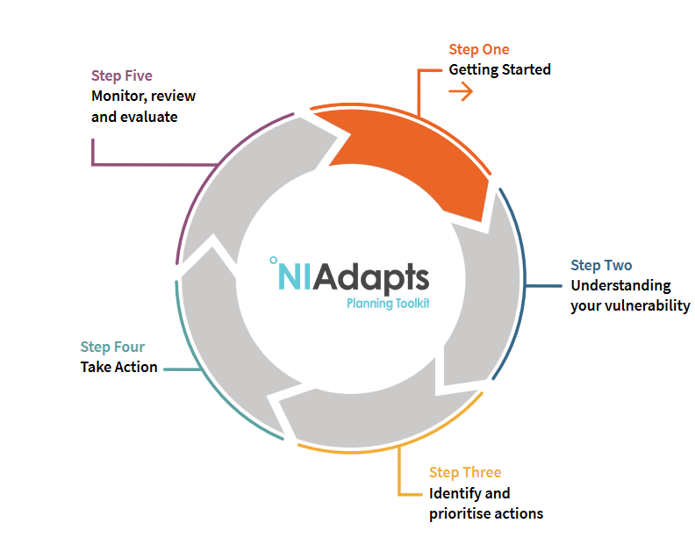
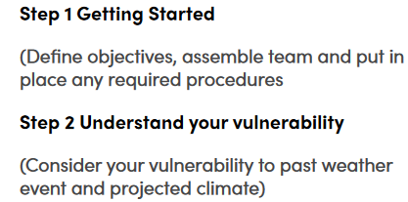
The Five Steps to creating an Adaptation Plan…
Initial Meetings covered Step 1 and Step 2…

Slide 4
The Five Steps to creating an Adaptation Plan…
Step 3 – Identify and Prioritise Actions (2 further workshops)
Develop Climate Risk Register (based on information gathered during today’s session)
Create Vision and Objectives
Co-create action plan with all services
Ratify

Slide 5
Workshop 2 Aims:
The aims of the workshop are to:
Understand adaptation planning progress so far and post-workshop call for actions
Further develop the Climate Adaptation Plan Working Group, and
Utilise staff knowledge to shape the draft adaptation plan; including risk register, vision and action plan.
Understand the process for feeding in actions ahead of Workshop 3

Slide 6
Group Exercise 1 - Review and Feedback on Draft Risk Register

Slide 7

Present Risks

Slide 8
Group Exercise 1 - Review and Feedback on Draft Risk Register
Present on Risk Register Scoring Matrix

Slide 9
Group Exercise 1 - Review and Feedback on Draft Risk Register (40 minutes – Groups split by Hazard)
Climate Hazard: Flooding (Increased Precipitation and Sea Level Rise)
Risk Statement (Impact and Consequence) and Risk Code (F) | Relevant Internal Departments/Service | Inherent Risk |  |  | Current Policies and Procedures
 |  | Likelihood | Impact | Risk Score
(F1) Increasing frequency and intensity of precipitation resulting in greater flood risk, affecting Council assets and operations leading to financial losses, increased insurance costs and additional resource. | Community Services, Capital Programmes, Emergency Planning, Communications, Finance | 4 | 4 | 16 | Emergency Plan, Departmental and Service policies and operational procedures
Risk Register - Review & Feedback
Are the Risk Statements accurate and are any missing?
Is your department/service listed beside the relevant Risk Statements?
What do you think of the current level of prioritisation (risk score)?
Are there any current policies and procedures you would like added? (Is there any current work not listed)

Slide 10
10 Minute Break

Slide 11
Presentation on Draft Vision and Strategic Aims

Slide 12
Draft Adaptation Plan Vision and Strategic Aims
Draft Vision
Draft Aims

Slide 13
Presentation on Draft Themes

Slide 14
Draft Adaptation Plan Themes
Draft Vision
Draft Aims
Draft Themes
Draft Risk Register

Slide 15
Group Exercise 2 - Review and Feedback on Draft Vision, Aims and Themes

Slide 16
Group Exercise 2 - Review and Feedback on Draft Vision, Aims and Themes (35 minutes)
Vision and Aims (10 mins)
Do you agree with the Vision statement?
Do the Strategic aims reflect the main priorities for the adaptation plan?
Adaptation Plan Themes
Do you agree with the Priority Themes as listed?
Do you agree with the aims and outcomes of each theme?
Propose actions to meet the outcomes (only if you have time)

Slide 17
Next Steps and Call for Actions

Slide 18
Next Steps and Call for Actions
Timeline to get comments after Workshop 2
Workshop 3
Plan goes to Committee/Board
One-to-One meetings with Senior Staff

