Slide 1
Workshop 1
-----------------
Your Organisation Vulnerability Assessment
Time | Agenda
13:00 | Introductions and Work so Far – Adaptation lead
13:10 | Vulnerability Workshop Introduction - Climate NI
13:25 | Interactive Mapping Session – MIRO Q. Identify examples of when council assets and services have been affected by weather events. 15 Minute exercise, 10 Minute feedback
13:55 | Group Exercise 1: Understanding Your Current Risk Q. Assess past weather events in more detail, including what was impacted, and any data available on the event (approx. 5 mins for each of the 5 hazards). Note: Think about how your service area has been impacted first and foremost. 30 Minute exercise, 15 Minute feedback
14:40 | 10 Minute Break
14:50 | What does a Future Climate Look Like? – Climate NI
15:00 | Group Exercise 2 – What Ongoing Work Addresses These Climate Risks? Q. For each weather hazard listed in Exercise 1, Identify the council policies and external partners relevant to addressing the impact of the event Consider the priority of the risk posed by the event Suggest what data could or should be collected. 20 Minute exercise, 5 Minute feedback
15:25 | Next Steps Group to discuss next steps and continued development of vulnerability assessment
15:30 | Close

Slide 2






Vulnerability Workshop Introduction

Slide 3
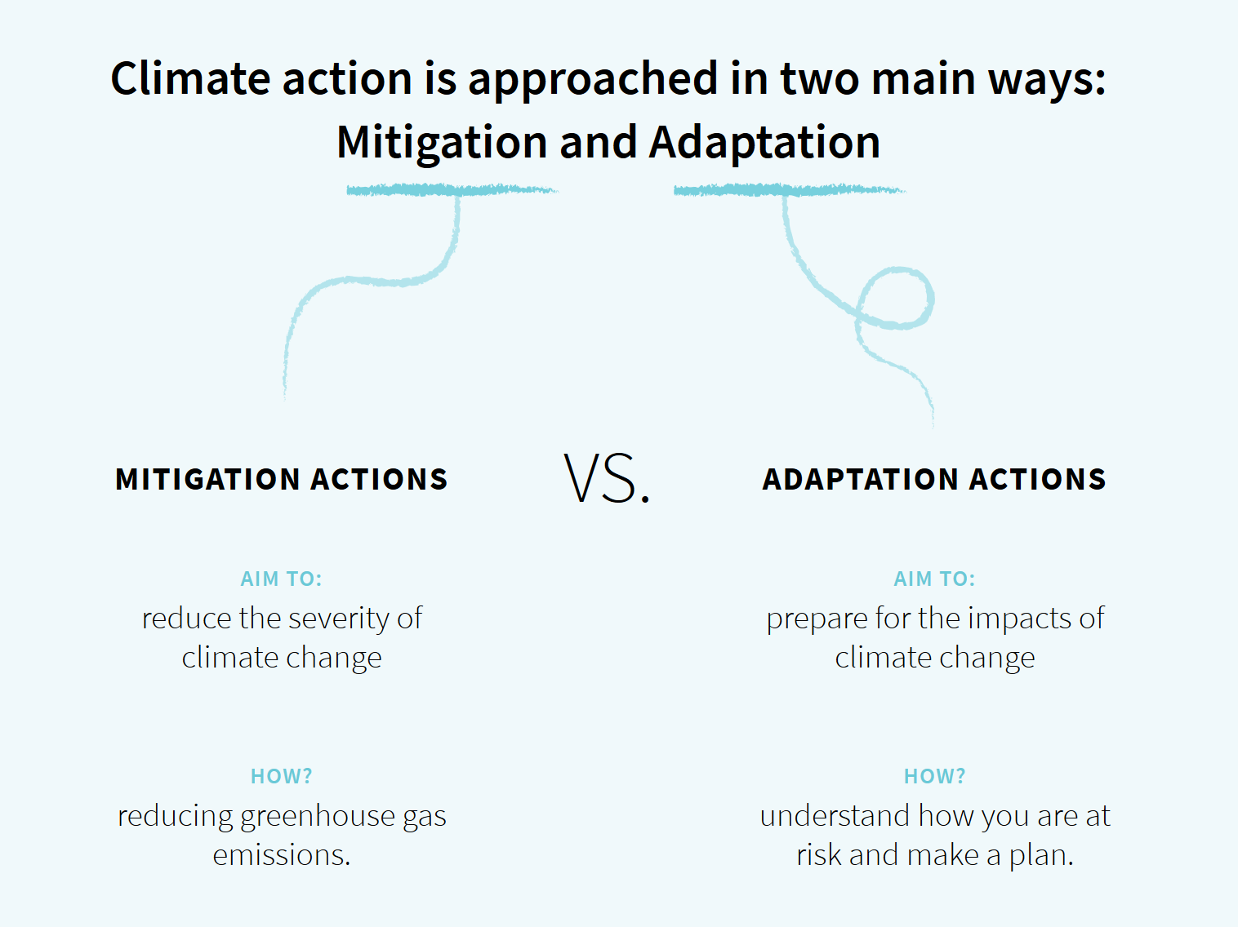
What exactly do we mean by ‘climate change adaptation’?
Even if we stop all our emissions today, we have now locked in some degree of climate change.
We must therefore prepare our society, environment and economy for the impacts of climate change (adaptation) at the same time as we cut our greenhouse emissions (mitigation).
It is vital that we pursue both actions in balance, to reduce the scale of climate change, but also to prepare for the impacts we cannot now avoid.

Slide 4

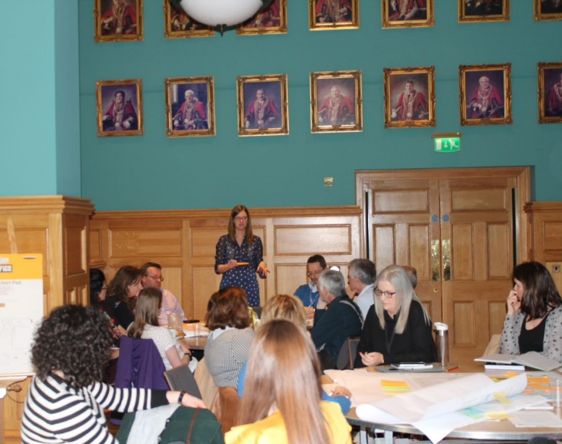
What is a climate adaptation plan?
An organisation-wide shift to ‘get your house in order’ so you can be the cohesive organisation that citizens need.
Priority 1: Prepare council assets and operations for the impacts of climate change.
Priority 2: Actions to build capacity within each service in council.
This is an imperfect, continual process and not a silver bullet against climate risk.
In the first instance: Communications and policy alignment
  “Developing a living, integrated adaptation plan to enable a strategic and systematic approach on resilience and climate change in Belfast City Council. The ambition is to engrain long-term change by enabling staff and elected members to see their value and role towards achieving climate resilience for the current and future citizens of Belfast.”

Slide 5

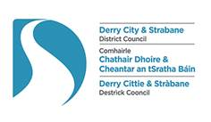

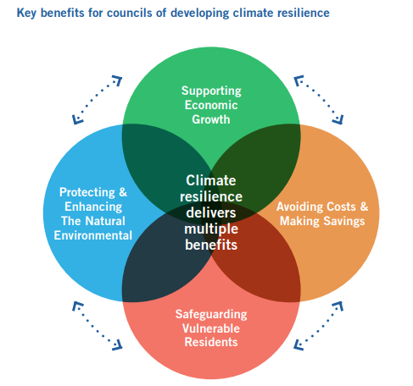
Why create a climate adaptation plan?
Derry City and Strabane District Council developed the first plan in NI (published July 2020), but every council in ROI already has one and all Scottish public bodies have to report on their adaptation action.
Councils have local knowledge, and play a linking role between central government and communities on the ground.
Councils are the frontline of emergency response and key planning role.
Costs and Capacity – better understand council thresholds, to avoid damage to both new and existing assets and service disruption.
Public is increasingly looking for action.
Climate justice – often the most vulnerable who are impacted the most.
Funding opportunities and projects e.g. North West Climate Action Network.
SOLACE agreed on developing an adaptation planning group by 2021.

Slide 6
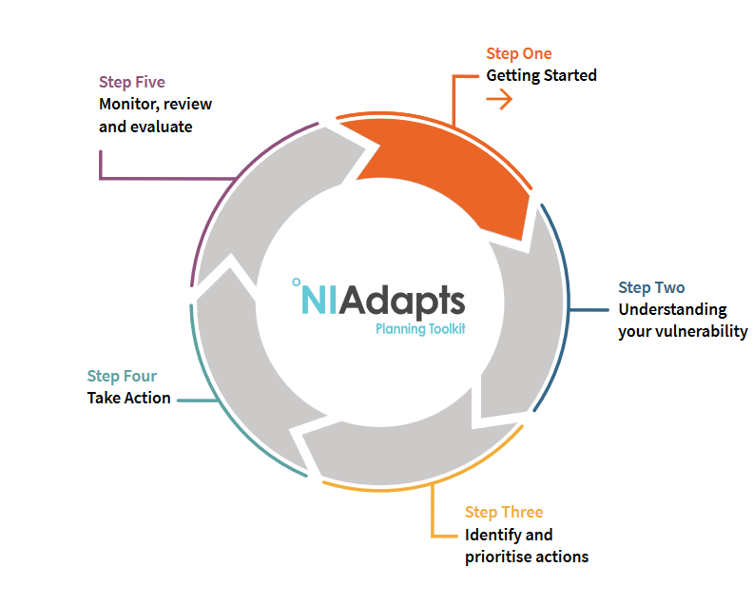
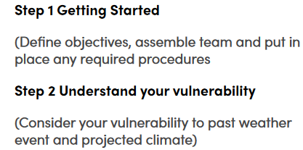
The Five Steps to creating an Adaptation Plan…
Initial Meetings cover Step 1 and Step 2…

Slide 7
Aims and Outcomes:
The aims of the workshop are to:
Understand the challenge of climate change and how it impacts NI
Initiate the Climate Adaptation Plan Working Group, and
Utilise staff knowledge to understand council vulnerability to past and future climate impacts.
After this workshop you should have:
An understanding of how your council service areas have already been affected by climate change,
An understanding of how climate change may impact your council services in future,
A list of work which is already underway to help your council become more resilient to the impacts of climate change, and
A list of data which could help you better understand and plan for the impacts of climate change.

Slide 8
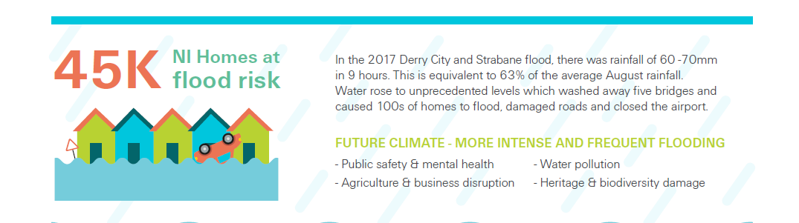
Flooding/High Rainfall
The consequences of climate change can include flooding, extreme storm surges, heat waves, wildfires and drought. Issues can also arise from moderate events and gradual changes.
Extreme events happen naturally and are already impacting on our society, communities, economy and natural environment.
A changing climate is a risk multiplier and interacts with factors such as city development, resilience and health inequalities.

Slide 9
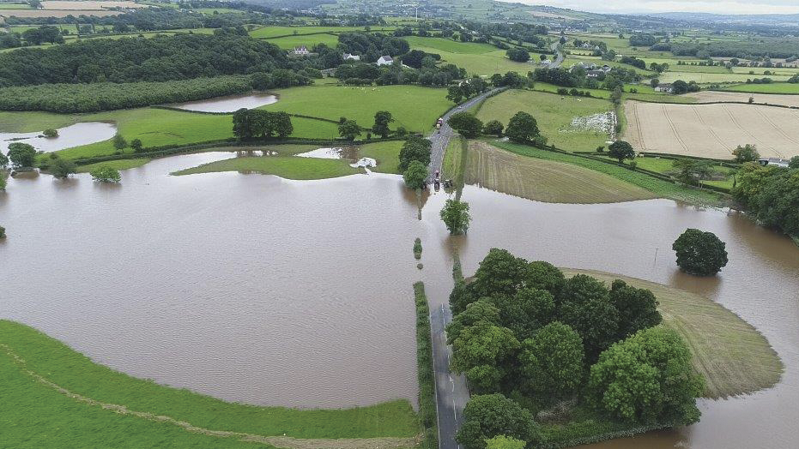
Derry City and Strabane District Council -
August 2017
63% of August's average rainfall fell within nine hours.
Hundreds of homes and businesses were flooded
Extensive damage to roads and bridges occurred, with 5 bridges being washed away.
City of Derry Airport was also closed for nearly two days due to the terminal being flooded; Costs of £300,000 (insured).
Firefighters saved 93 people, with the Coastguard helping dozens of others.
https://www.bbc.co.uk/news/uk-northern-ireland-41019610

Slide 10
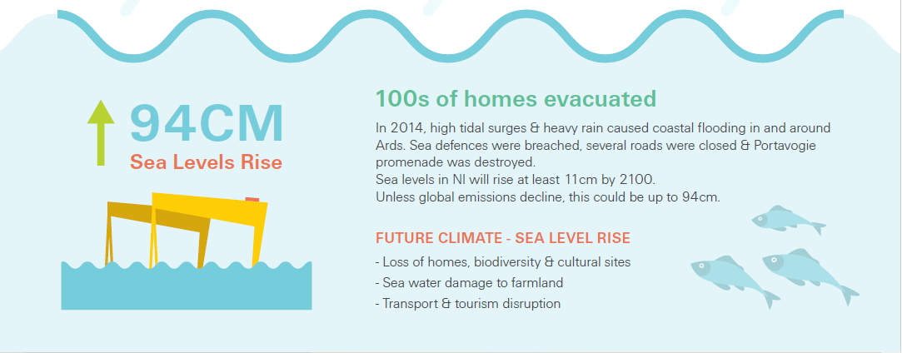
Sea Level Rise

Slide 11
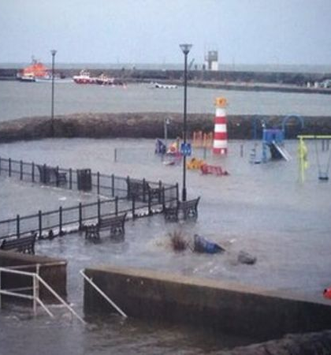
January 2014-
Tidal surge
High tides and strong winds caused flooding in some coastal areas of Northern Ireland.
River Bann flooded part of Coleraine, County Londonderry, and several coastal paths were impassable.
The main Newtownards to Portaferry coastal road in County Down was closed, and there was flooding in parts of Holywood and Millisle in County Down, and Carrickfergus, County Antrim.
The sea wall in Cushendall had been breached in two places with waves as high as 40ft.
Several thousand sandbags were made available and several hundred residents.
Travel disruption.
https://www.bbc.co.uk/news/uk-northern-ireland-25580692

Slide 12
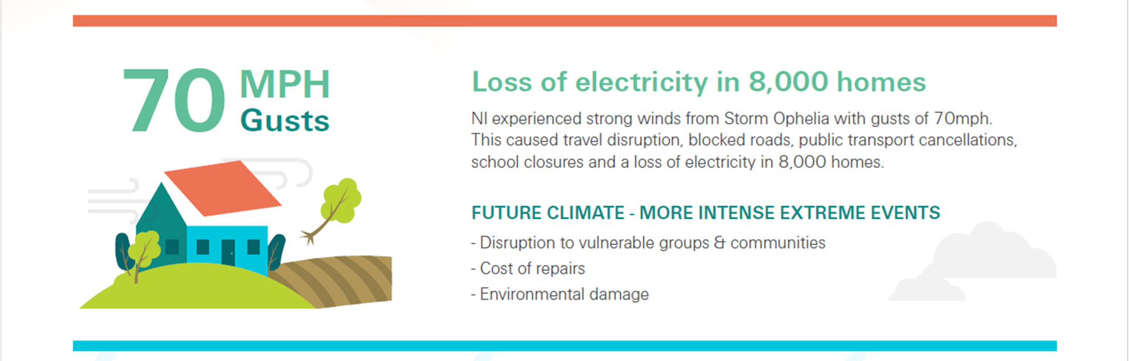
Storms

Slide 13
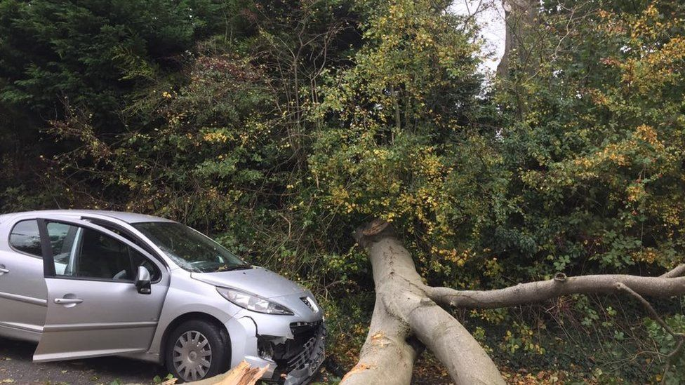
Mid & East Antrim
October 2017-
Hurricane Ophelia
8,000 homes had no electricity in Northern Ireland.
Many non-essential council services were suspended.
High waves cause damage across Ireland.
Gusts hit up to 100 mph in some areas felling trees and power lines.
Roads closed and sea, rail and bus services were cancelled or severely delayed.
Residents were evacuated from flats in Rodgers Quay, Carrickfergus, due to the risk of flooding from tidal surges.
https://www.bbc.co.uk/news/uk-northern-ireland-41632835

Slide 14
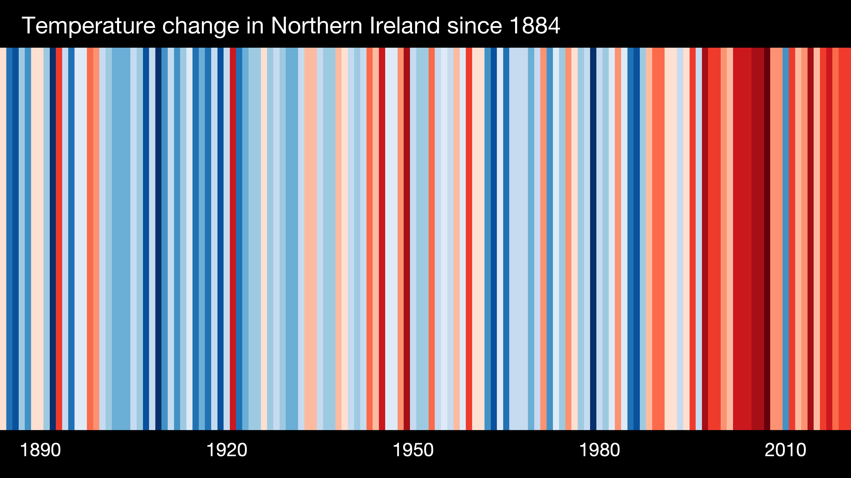
Heat
Source: Ed Hawkins

Slide 15
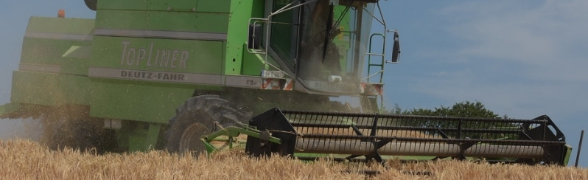
Newry, Mourne & Down
June 2020 -
“Northern Ireland under worst drought since 1976”
Unusually dry spell and the sunniest spring ever (52% of the spring average), with records dating back to 1929.
The average spring 2020 temperature for Northern Ireland was at 13.04 °C, which was 1.25 °C higher than normal.
Downpatrick farmer Allan Chambers (UFU Seeds and Cereals Committee) expected crop yield to be down by as much as 50% - something which could lead to a drop in income in the region of 60 000 euros.
"It just hasn’t rained for two-and-a-half months. I’m farming now for almost 60 years, and this is the most extreme spring that I have ever seen."
“There’s no doubt that we’re getting more extremes of weather…For instance, last winter’s continuous rain. And this summer’s continuous dry weather. This is extremely unusual that the two would happen within a 12 month period."
https://watchers.news/2020/06/05/northern-ireland-under-worst-drought-since-1976/

Slide 16
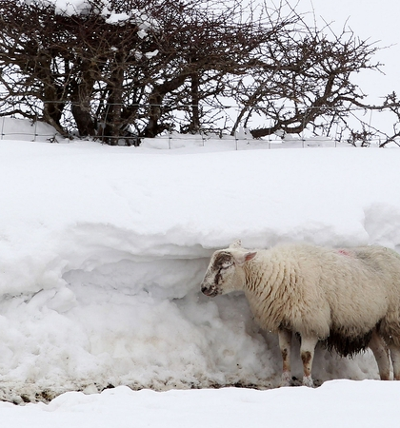
Causeway Coast & Glens/ Newry, Mourne & Down
March 2013 - Cold Snap
Around 44,000 farm animals died during cold spell.
Massive snow drifts in parts of counties Down and Antrim left sheep stranded in remote areas and British and Irish relief helicopters were brought into air lift feed.
Hardship funding measures issued to assist farmers worst affected by livestock losses.
Power supplies were cut off, phone signals were down, and emergency services had to transport food and medicines to some people in isolated areas using military helicopters from the RA and the Air Corps.
https://www.rte.ie/news/2013/0429/387557-farm-animals-weather/

Slide 17
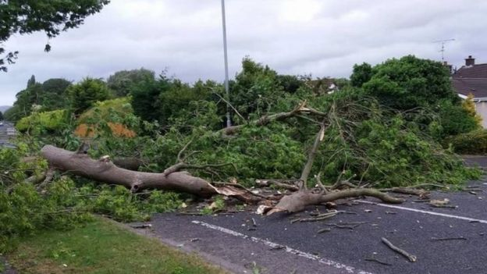
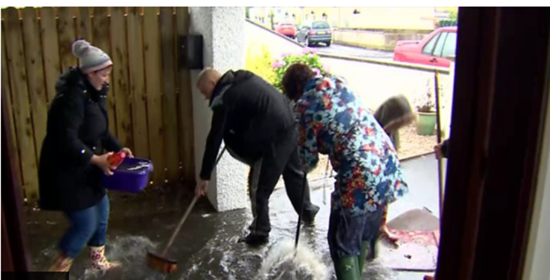
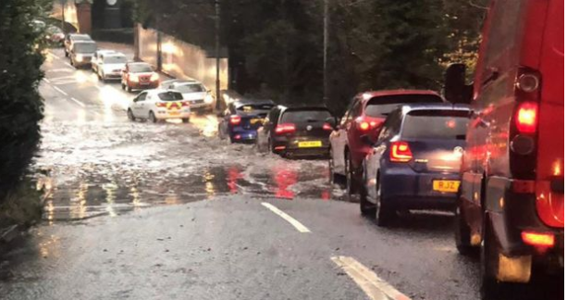
Your organisation – Examples of extreme weather impacts
Storm Hector (June, 2018)
Gusts of 69mph recorded at Ballypatrick Forest
Eighth named storm of 2017-2018
Storm Hector brought down trees, branches and power lines across Northern Ireland
Debris had been cleared from about 200 roads
Flooding (July, 2018)
88.2mm of rainfall (A month's worth of rain fell within a few hours)
A number of elderly people had to leave their homes in the County Antrim village of Muckamore due to flooding.
Storm Francis (August, 2020)
40mm to 50mm have fallen in and around the Sperrins and the Antrim hills.
Roads and transport lines have closed across NI.

Slide 18
Workshop 1
-----------------
Your Organisation Vulnerability Assessment
 | Interactive Mapping Session – MIRO Q. Identify examples of when council assets and services have been affected by weather events. 15 Minute exercise, 10 Minute feedback
 | Group Exercise 1: Understanding Your Current Risk Q. Assess past weather events in more detail, including what was impacted, and any data available on the event (approx. 5 mins for each of the 5 hazards). Note: Think about how your service area has been impacted first and foremost. 20 Minute exercise, 10 Minute feedback

Slide 19
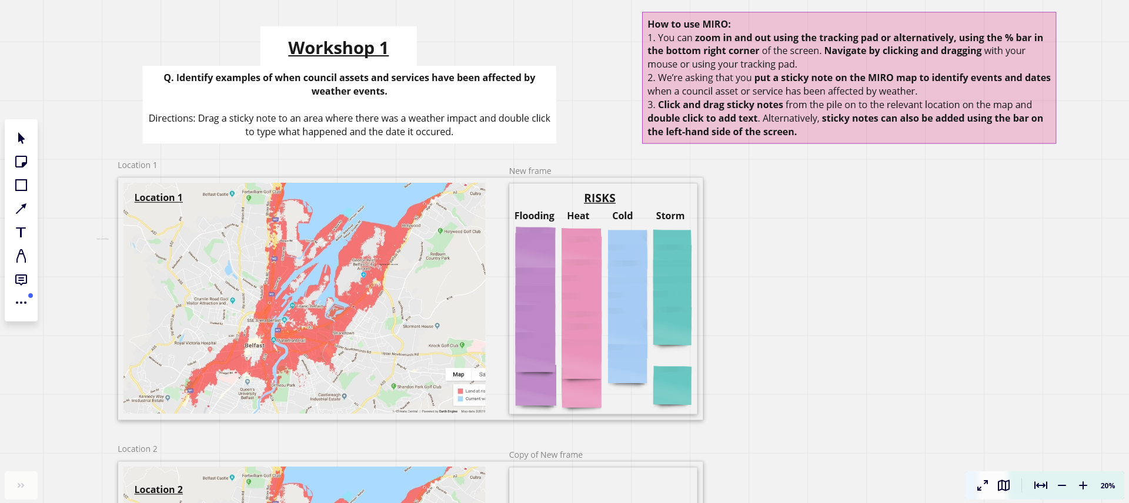
Interactive Mapping Session
Click the MIRO link in your agenda/email to access the exercise
15 Minute exercise, 10 Minute feedback
Additional Sticky Notes
Drag sticky note onto the map and double click to type
Zoom in and out

Slide 20

Exercise 1: Assess past weather events in more detail, including what was impacted, and any data available on the event (approx. 5 mins for each of the 5 hazards).
Note: Think about how your service has been impacted first, before thinking about the wider council.
Exercise 1 – Current Vulnerability
Hazard | Description, Location and Date of Event | Consequence of Event (Detail what was affected and how) |  |  | What data is available? (Financial cost, overtime etc…)
 |  | Council Function and Services | Council Buildings and Staff | Businesses and Communities
River Flooding/High Precipitation | Heavy Summer rainfall event dropped 63% average august rain in 9 hours, Drumahoe, August 2017 | Emergency response required. Waste collection badly disrupted for one week, leisure centres closed, staff unable to get to work affecting key council functions, parks damaged… | Leisure centres badly damaged, staff unable to get to work, staff overtime required, fleet vehicles swept away, hundreds of additional environmental health inspections | 100s of Businesses and homes damaged, oil tanks washed into rivers, emergency shelter required | Overtime and business losses were not calculated. Council losses of £360,000, and additional insurance payments
Heatwave/Successive Days of High Temp/Low Rainfall
Storms
Intense Cold
Gradual Change (e.g. Sea Level Rise/ Longer Growing Season)

Slide 21
Workshop 1
-----------------
Your Organisation
Vulnerability Assessment
 | What does a Future Climate Look Like? – Climate NI
 | Group Discussion: Future Risk Q. What might the vision of the future climate mean for Your Organisation?

Slide 22
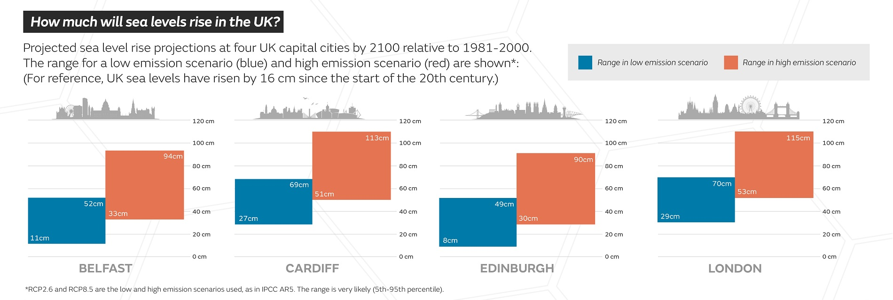
Looking ahead, the Met Office UK Climate Projections (2022)
say that we can expect…
'an increased chance of warmer, wetter winters and hotter, drier summers along with an increase in the frequency and intensity of extremes.' (UKCP18, 2022)
Note: Cold snaps, drier winters and wet summers will still occur.
This means we must be prepared for a greater range of extremes year to year
Sea levels on our current emissions path are projected to rise by up to 94cm in NI by 2100.
(UKCP18, 2018)
Notes:
Source: https://www.metoffice.gov.uk/binaries/content/assets/metofficegovuk/pdf/research/ukcp/ukcp18_headline_findings_v4_aug22.pdf

Slide 23
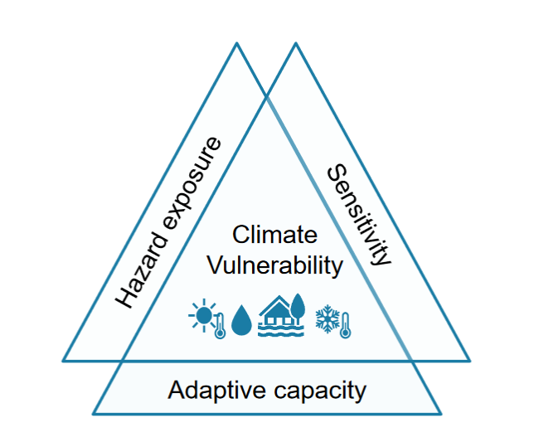
But we cannot assess weather changes in isolation…
Range of slow-onset and gradual change events can breach capacity
Cascading impacts – e.g. Storm Surge and High Tide + Sea Level Rise
International Impacts – Supply Chain Disruption
Let's look at the likely scenario for the higher emissions pathway...
Figure taken from: ARUP (2019) Belfast Climate Risk Assessment for Infrastructure Assets

Slide 24
Flooding/High Rainfall
Average Winter Rainfall
By mid-century: Likely to increase by up to 10%
End of century: Likely to increase by up to 20%
Note: This represents average rainfall, so some winters will have much higher rainfall.
Met Office, UKCP18 Probabilistic projections (RCP8.5)

Slide 25
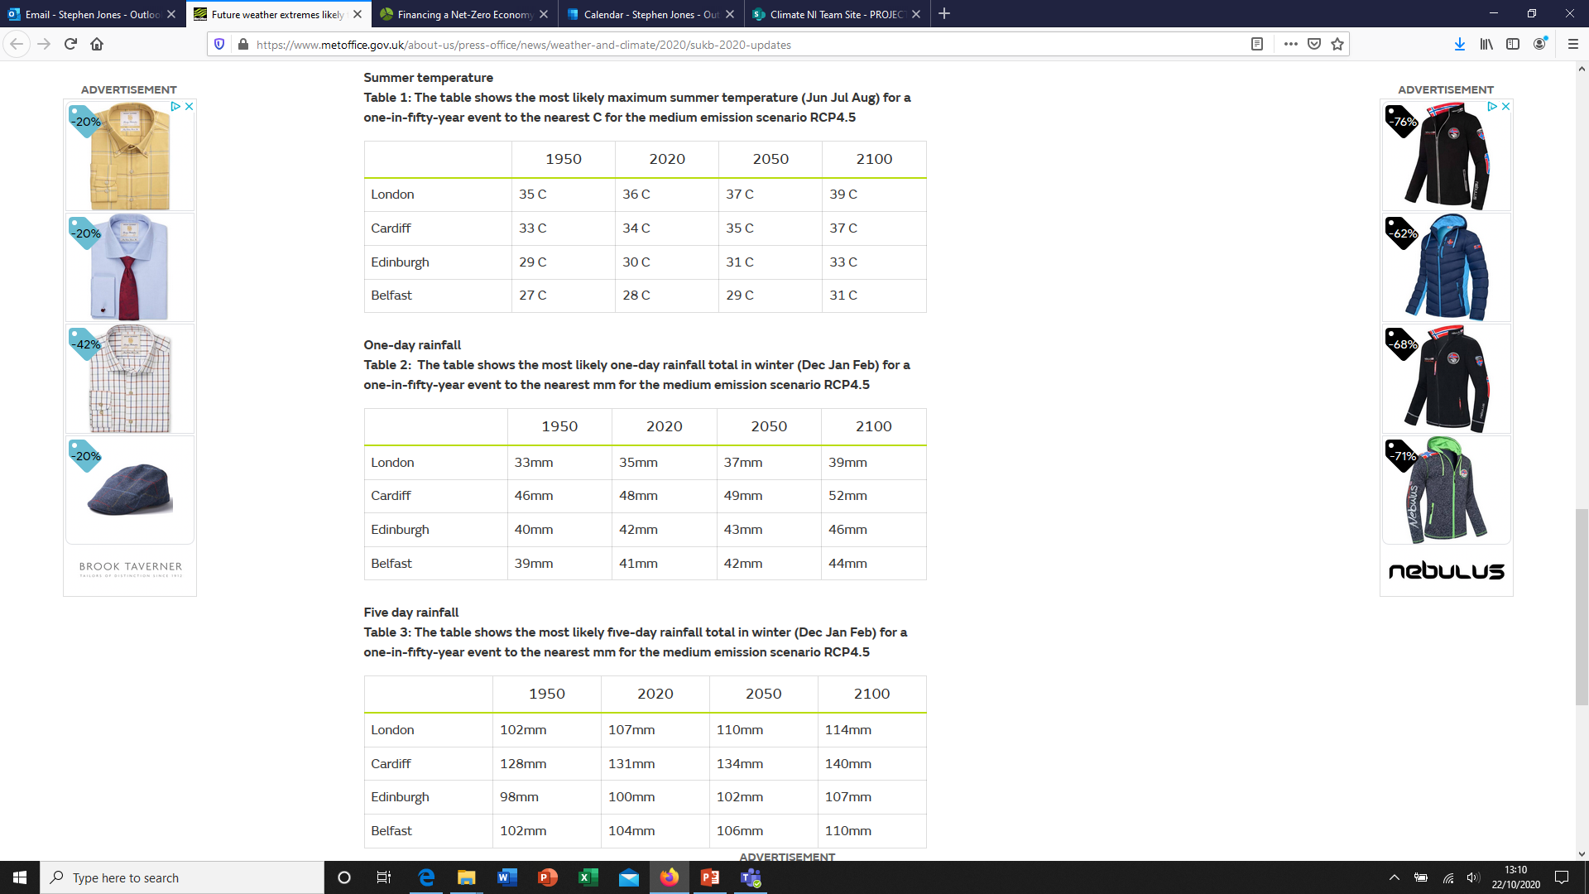
The amount of rain from extremely wet days has increased by 17% when comparing the most recent decade (2008-2017) with 1961-1990.
Winter rainfall extremes becoming more extreme, even in a scenario where we cut emissions.
We are on track for a global average temperature around twice as warm as projected for these numbers.
https://www.metoffice.gov.uk/research/climate/understanding-climate/uk-extreme-events_heatwaves

Slide 26
Sea Level Rise
Sea levels on our current emissions path are projected to rise by up to 94cm in NI by 2100.
Met Office, UKCP18

Slide 27
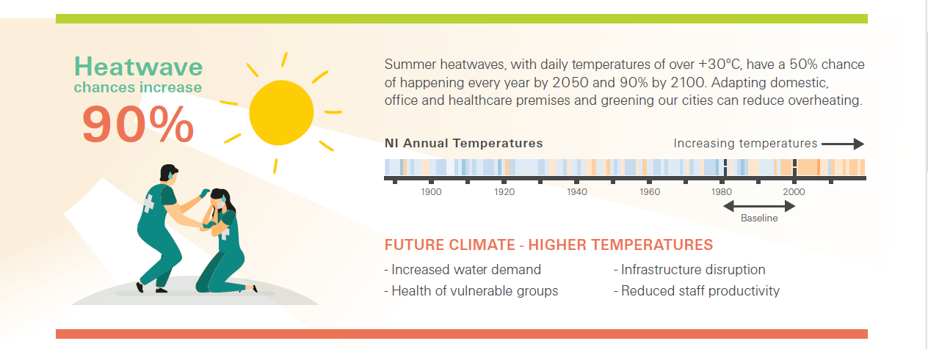
Heat
Daily Maximum Temperature in Summer
By Mid-century: Likely to be up to 3 °C hotter
End of century: Likely to be up to 5 °C hotter
Note: These are average temperatures, so the actual temperature on some days will be much hotter.
Met Office, UKCP18 Probabilistic projections (RCP8.5)
Summer Heat extremes becoming more extreme, even in a scenario where we cut emissions.
We are on track for a global average temperature around twice as warm as projected for these numbers.
https://www.metoffice.gov.uk/research/climate/understanding-climate/uk-extreme-events_heatwaves

Slide 28
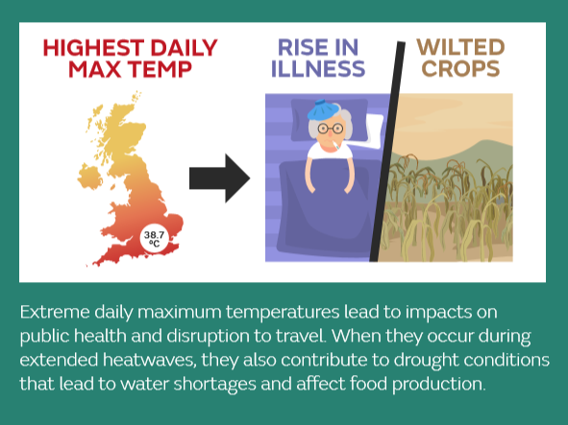
Average Summer Rainfall
There is some additional uncertainty here – could go up on average under extreme scenario or down on average, but with heavy downpours.
Mid-century: Likely to decrease by up to 20%
End of century: Likely to decrease by up to 30%
This could have an impact on the built environment, river flow, water quality and public water supply or increased respiratory problems from dust and pollen.
Excess deaths
Better In Winter due to Daily Minimum Temperature Winter rising by about 2 °C on average
But many more in Summer due to heat and building insulation
Cold winters and temperatures, will still occur as a result of natural variations in the climate system. We expect them to be less frequent, but this means we must plan for a wider range of climatic extremes as the norm becomes increasingly warmer.
Met Office, UKCP18 Probabilistic projections (RCP8.5)
https://www.metoffice.gov.uk/research/climate/understanding-climate/uk-extreme-events_heatwaves

Slide 29
Storms
Met Office research in this area is still under development, but some studies suggest that North Atlantic storms are increasingly likely to track further East over Ireland throughout the 21st century.

Slide 30
Workshop 1
-----------------
Your Organisation
Vulnerability Assessment
 | Group Exercise 2 – What Ongoing Work Addresses These Climate Risks? Q. For each weather hazard listed in Exercise 1, Identify the council policies and external partners relevant to addressing the impact of the event Consider the priority of the risk posed by the event Suggest what data could or should be collected. 15 Minute exercise, 5 Minute feedback
 | Next Steps Group to discuss next steps and continued development of vulnerability assessment
16:00 | Close

Slide 31
Group Exercise 2 – What ongoing work relates to these climate risks?
For each event listed in Exercise 1,
Identify the council policies and external partners relevant to addressing the impact of the event
Consider the priority of the risk posed by the event
Suggest what data could or should be collected.
Exercise 2 - What ongoing work addresses these climate risks?
Hazard | Policies and Procedures (What current policies and procedures are in place to address these impacts? E.g. key strategies, insurance, operations plans, emergency plans etc...) | External Organisations (What statutory or community bodies do you need collaborate with to address these impacts?) | What level of priority is this risk? (Scale of the impact vs importance/sensitivity the affected asset) | What data do we need to gather? (What data should be gathered to provide a clearer picture? Could be new or existing)
River Flooding/High Precipitation | Emergency plan, business continuity plan, corporate risk assessment, health and safety… | Housing Executive, DfI, DAERA, PHA… | High – Significant impact and damaged key council assets, homes and businesses… | Staff overtime cost, local business losses, number of homes affected, future flood projections, repair costs, disruption, insurance…
Heatwave/Successive Days of High Temp/Low Rainfall
Storms

Slide 32
Workshop 1
-----------------
Your Organisation
Vulnerability Assessment
15:50 | Next Steps Group to discuss next steps and continued development of vulnerability assessment
16:00 | Close

