Slide 1



Climate Change Adaptation Plan – Step 1
Core Working Group
Meeting 1
(Amend slides as applicable)
YOUR LOGO HERE


Slide 2

Agenda
Introductions
Why do we need a Climate Adaptation Plan?
Terms of Reference and Teams/File Sharing
Adaptation Scoping Exercise
Break
Extended Invite List for Future Workshops
Next Steps - Vulnerability Assessment (Workshop 1) Methodology
Discussion
Close

Slide 3





Why do we need an Adaptation Plan?

Slide 4
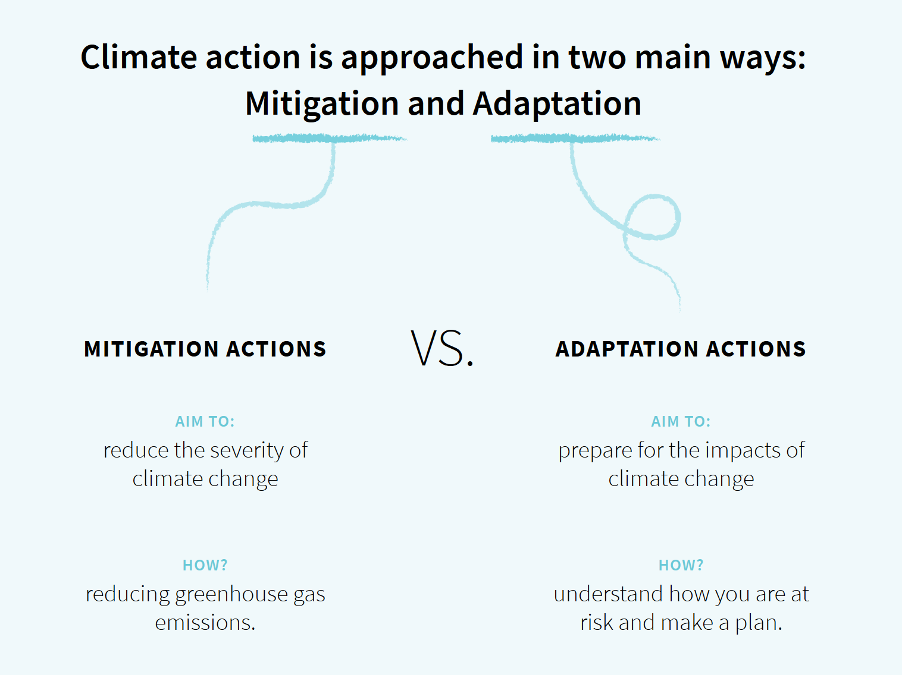
What exactly do we mean by ‘climate change adaptation’?
Even if we stop all our emissions today, we have now locked in some degree of climate change.
We must therefore prepare our society, environment and economy for the impacts of climate change (adaptation) at the same time as we cut our greenhouse emissions (mitigation).
It is vital that we pursue both actions in balance, to reduce the scale of climate change, but also to prepare for the impacts we cannot now avoid.
Gathering your knowledge and creating this group is an important first step to developing an adaptation plan.
Notes:
IPCC say that we need to keep below 4 degrees – we need to get a balance between mitigate and adapt – we have caused damage - to do that we need to….
On that basis there are two ways we need to respond to it. The issues are clear – we need to both ‘mitigate’ and ‘adapt’. We know that To mitigate, we need to reduce emissions. To adapt, we need to deal with the inevitable changes that are already underway.
The familiar: Current mitigation approaches are having limited impact…
The unfamiliar: Adaptation is low and the agenda is less understood…

Slide 5

The Background
As part of the CLIMATE project, Climate NI supported Derry City and Strabane through development of the first Climate Adaptation Plan in NI (published July 2020).
This led to the creation of the Local Government Climate Action Network (LGCAN), which now aims to support development of the first plan in every council in NI.
Project
June 2017-May 2020
€1.3m INTERREG VB transnational project
DCSDC Lead Partner
International expertise & best practice
DCSDC Adaptation Plan Vision
“That Derry City & Strabane District Council is better prepared and more resilient to the effects of climate change, creating a safe and sustainable region for all”

Slide 6
Derry City and Strabane District Council
Climate Adaptation Plan
Please follow the link below to watch the video:
https://youtu.be/5Wo7WwKgBXs

Slide 7
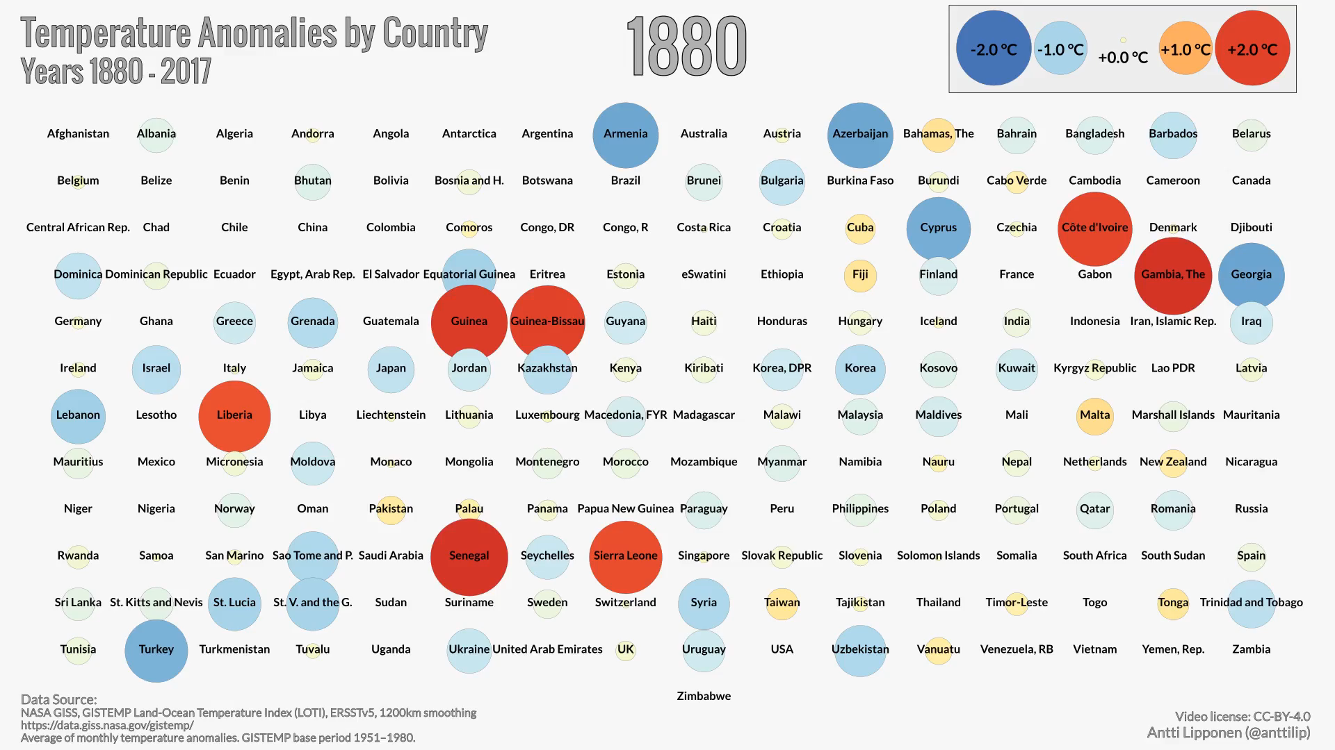
Global Temperatures are rising…

Slide 8
How will climate change impact NI?

Slide 9

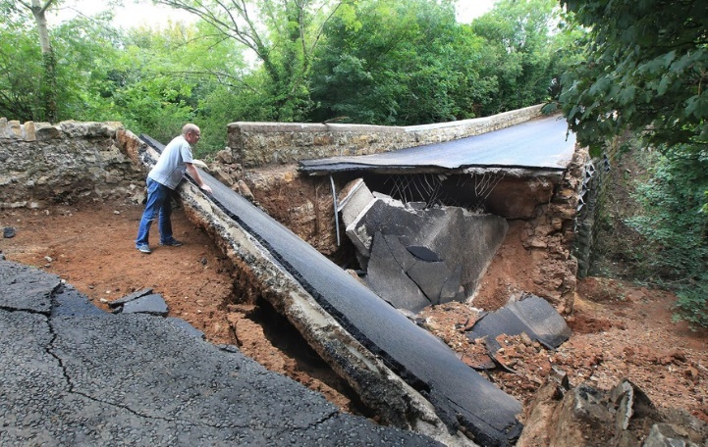
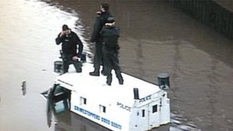
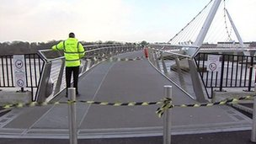
The consequences of climate change can include flooding, extreme storm surges, heat waves, wildfires and drought. Extreme events are already impacting on our society, communities, economy and natural environment.
In August 2017 flood event - Hundreds of homes and businesses were flooded and extensive damage to roads and bridges occurred, with 5 bridges being washed away. City of Derry Airport was also closed for nearly two days due to the terminal being flooded.
February/March 2018 saw the arrival of ‘the Beast from the East’ Widespread transport disruption; healthcare provision was significantly impacted.
June/July 2018 - First hosepipe ban in NI in over two decades.

Slide 10
This has significant cost implications, but the full extent of damages is not always easily assessed due to gaps in data. This has an impact on the ability to form a business case for climate action.
Derry City and Strabane District Council - August 2017 Floods:
Circa £350,000 on capital repair costs to Council assets and facilities
Circa £36,000 on emergency response costs
Plus significant staff time spent on response and follow up support with the communities
The World Economic Forum Global Risks Report 2020 stated that the top risks in terms of likelihood in the next 10 years were from climate change:
1. Extreme weather events with major damage to property, infrastructure and loss of human life.
2. Failure of climate-change mitigation and adaptation by governments and businesses.

Slide 11
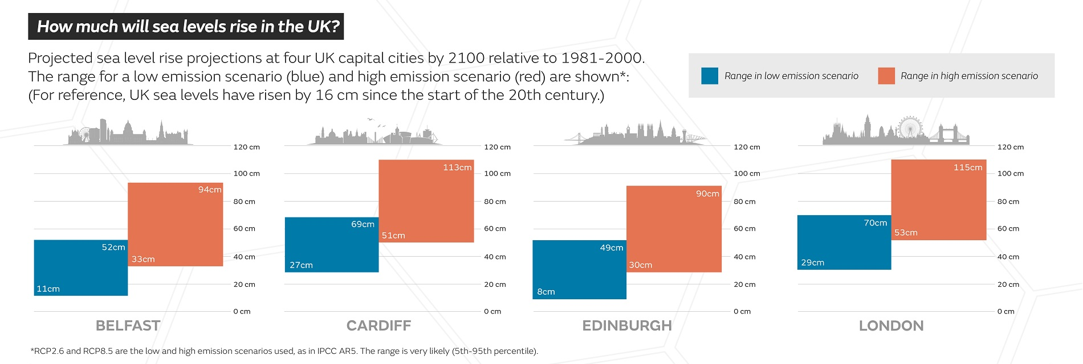
Looking ahead, the Met Office UK Climate Projections (2022)
say that we can expect…
'an increased chance of warmer, wetter winters and hotter, drier summers along with an increase in the frequency and intensity of extremes.' (UKCP18, 2022)
Note: Cold snaps, drier winters and wet summers will still occur.
This means we must be prepared for a greater range of extremes year to year
Sea levels on our current emissions path are projected to rise by up to 94cm in NI by 2100.
(UKCP18, 2018)
Notes:
Source: https://www.metoffice.gov.uk/binaries/content/assets/metofficegovuk/pdf/research/ukcp/ukcp18_headline_findings_v4_aug22.pdf

Slide 12

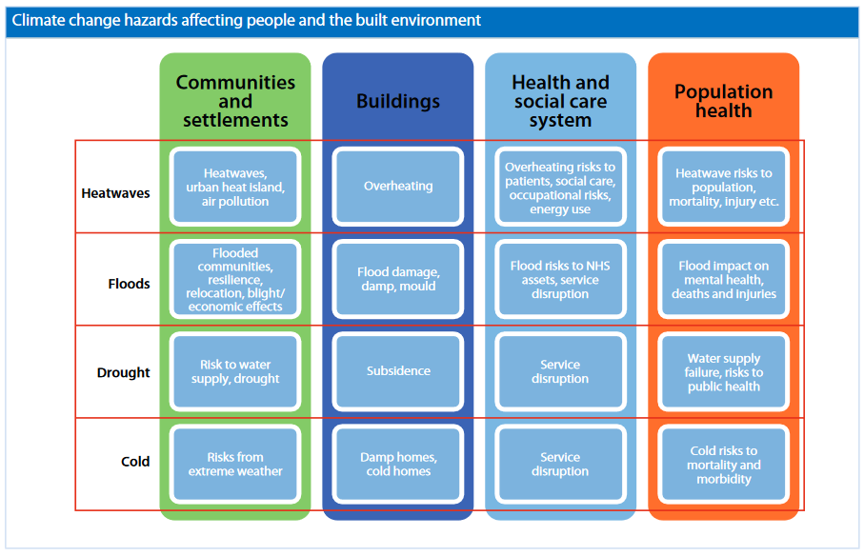
Communities that are already socially vulnerable (with less capacity to adapt) are most likely to be impacted.
We need to design for future climate rather than relying on our perceptions of past climate.

Slide 13
What are the Policy Drivers for Adaptation Planning?

Slide 14


Climate Change Act (Northern Ireland) 2022
The Act creates a target for net zero greenhouse gas emissions by 2050, with bridging targets for 2030 and 2040.
The Act sets out responsibilities for:
5-yearly Carbon Budgets
Development and publication of Climate Action Plans
Departments in Northern Ireland will publish sectoral plans
Creation of new independent office – Northern Ireland Climate Commissioner.
Develop regulations for Public Body Reporting on Climate Change
Notes:
Further information: https://climatenorthernireland.org.uk/climate-change-act-northern-ireland-2022/
Society can respond to climate change through mitigating against further warming by reducing our green house gas emissions and increasing carbon storage and by adapting to current and predicted impacts.
Adaptation - Planned process of adjustment to climate change and its effects.
• The aim of adaptation is to reduce the vulnerability of our environment, society and economy, and to increase resilience.
Climate Adaptation
• Adaptation also brings potential opportunity through green growth, innovation, jobs and ecosystem enhancement as well as improvements in areas such as water and air quality.
In June 2022 the Climate Change Act (Northern Ireland) received royal assent. The Act creates a target for net-zero greenhouse gases by 2050, with bridging targets for 2030 and 2040. 4
The Act requires the development and publication of Climate Action Plans. Climate Action Plans are the key delivery vehicle for meeting carbon budgets. The first 5-year plan will be laid by the end of 2023. Climate Action Plans require 16-weeks of consultation and have to include:
Policies and proposals from all NI departments
Annual Greenhouse Gas and air quality targets
Soil quality and biodiversity targets
In order to meet the goal of net-zero by 2050, the departments in Northern Ireland are tasked with publishing plans for different sectors of the economy. These plans, known as sectoral plans must also support a just transition.
Sectoral plans set out how specific sectors will contribute to the specific targets in the bill. There will be sectoral plans for:
Energy
Industrial processes
Transport
Infrastructure
Waste management
Agriculture
Fisheries

Slide 15
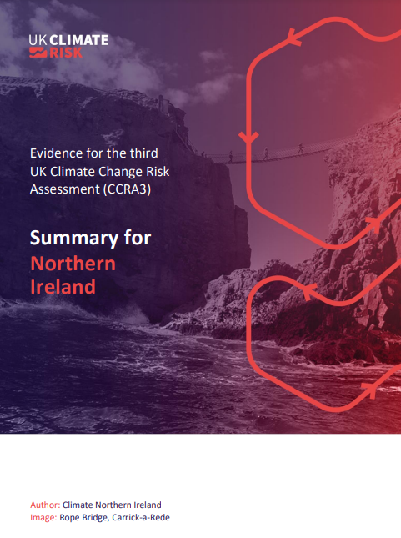
As well as outlining key greenhouse gas targets, the UK Climate Act 2008 requires that every five years, UK government gathers evidence for how climate change will impact NI.
The most recent Independent Climate Change Risk Assessment (CCRA) was published in 2021.
It sets out the risks and opportunities facing each sector from climate change:
Natural Environment & Natural Assets
Infrastructure
People and the Built environment
Business & Industry
International Dimensions
Notes:
IPCC say that we need to keep below 4 degrees – we need to get a balance between mitigate and adapt – we have caused damage - to do that we need to….
On that basis there are two ways we need to respond to it. The issues are clear – we need to both ‘mitigate’ and ‘adapt’. We know that To mitigate, we need to reduce emissions. To adapt, we need to deal with the inevitable changes that are already underway.
The familiar: Current mitigation approaches are having limited impact…
The unfamiliar: Adaptation is low and the agenda is less understood…

Slide 16
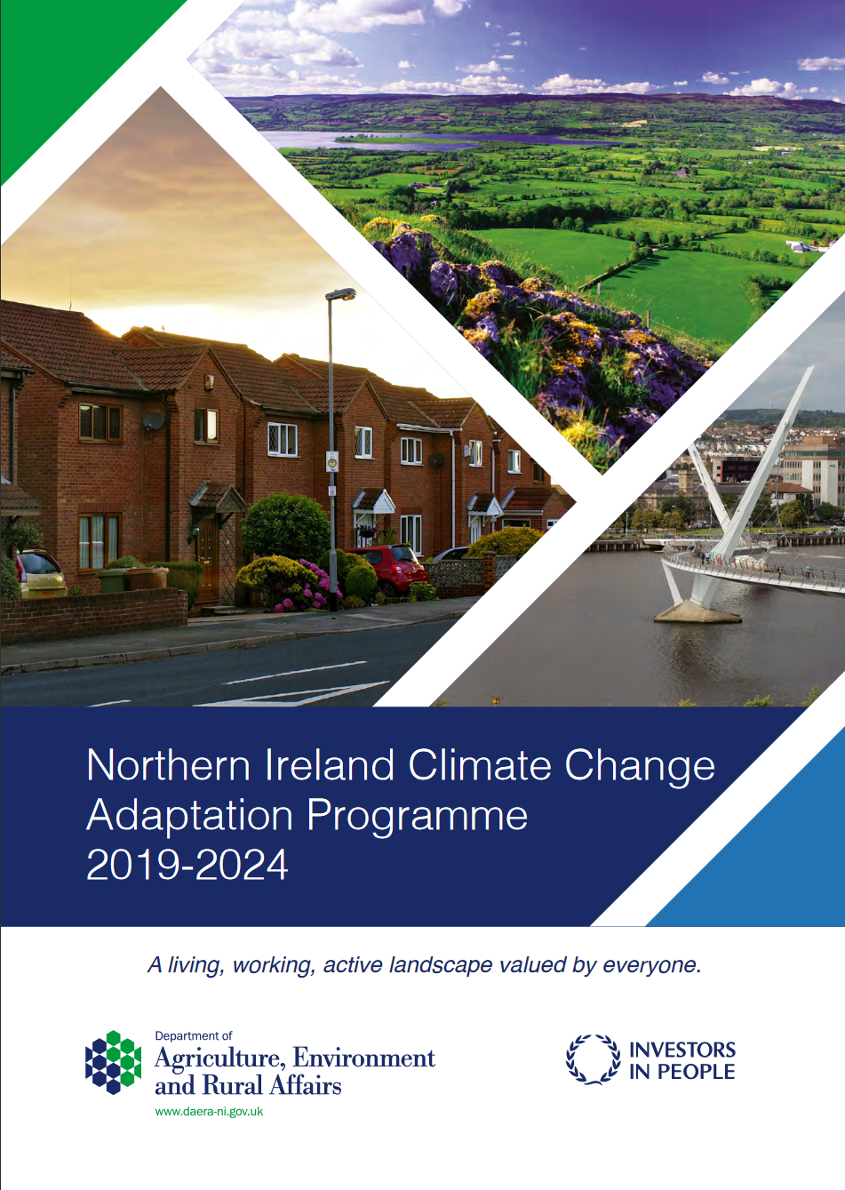
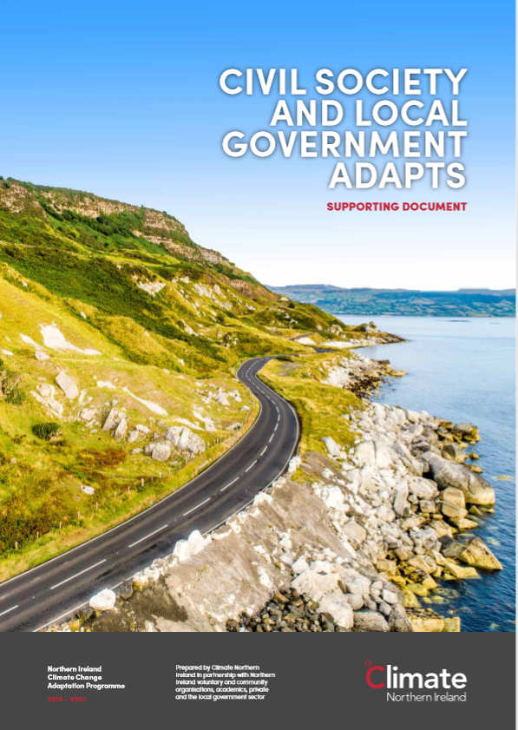
NI Government then responds to the UK CCRA with a 5-yearly Northern Ireland Climate Change Adaptation Programme (NICCAP), most recently in 2019.
The 2019 NICCAP report featured a ‘Civil Society and Local Government Adapts’ chapter for the first time.
This includes the following action, as agreed by SOLACE, NI Local Government Association, Climate NI and Sustainable NI:
Work with Local Councils to embed the adaptation cycle across council planning, with the aim of encouraging councils to complete a minimum of :
Step 1 by 2021
(Developing an Adaptation Planning Working Group)
Step 4 by 2024
(Completing full adaptation plan, including risk register and action plan.)

Slide 17


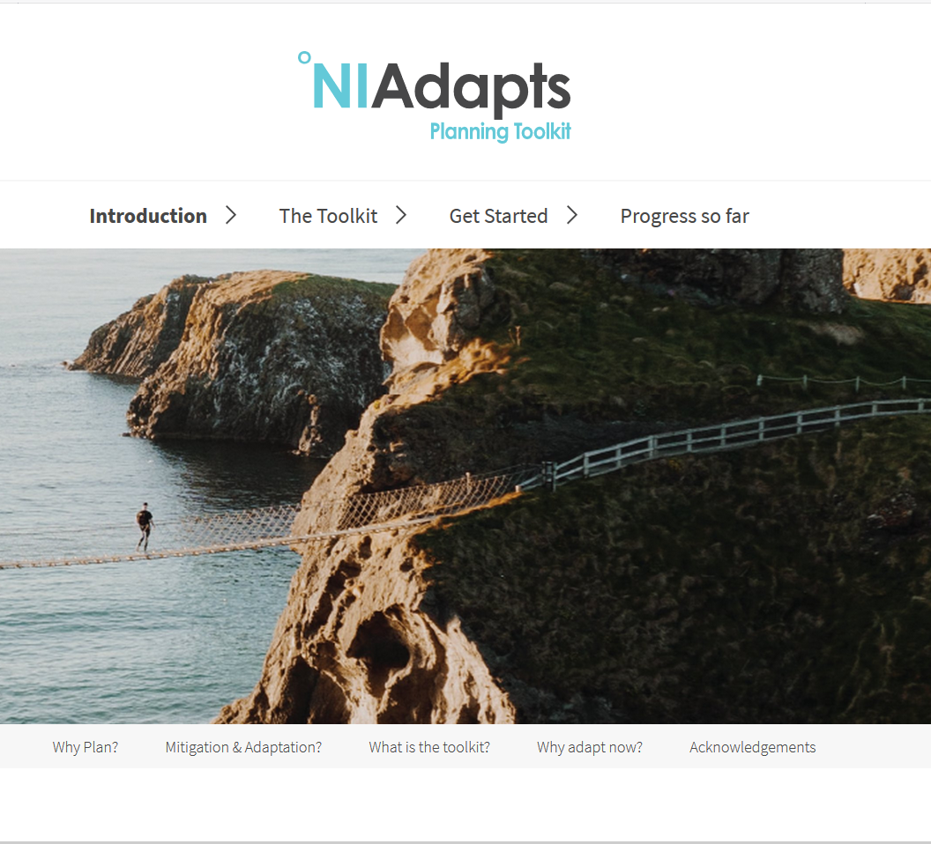
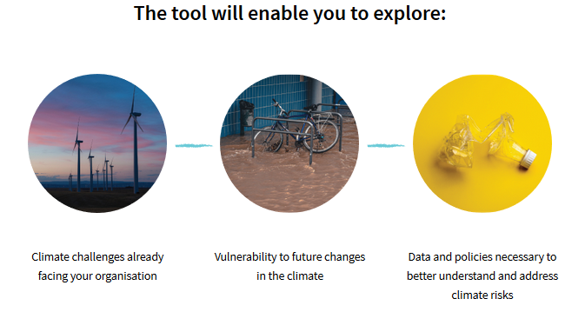
What does this mean for your Organisation?
Your working group, led by the Adaptation Lead and supported by Climate NI and LGCAN, can follow the same process as Derry City and Strabane District Council and create your own adaptation plan.
The online ‘NI Adapts’ platform offers a step-by-step guide to follow.

Slide 18

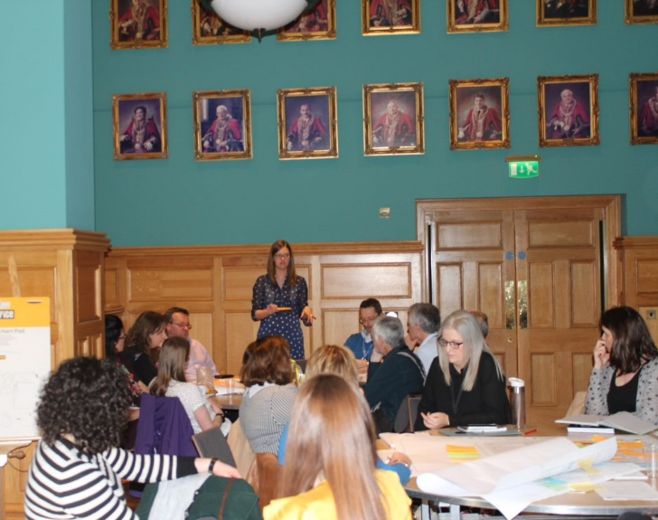
What is a climate adaptation plan?
A ‘Climate Ready’ Vision
An organisation-wide strategy which assesses the priority vulnerabilities to climate change and embeds action within all policies, services, risk registers and staff training as part of cohesive response.
A series of small changes as part of a bigger picture
This is an iterative process for decades to come: assessing the current impacts and future risk, before developing an action plan with buy-in from senior management and elected members.

Slide 19


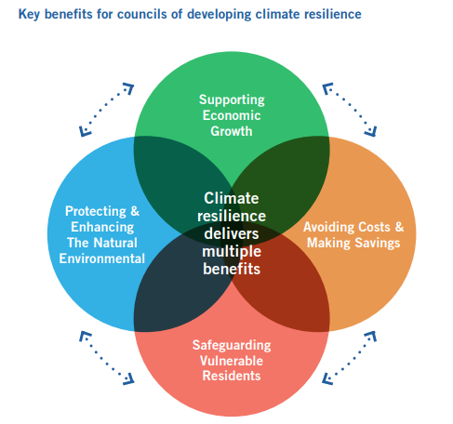
Why create a climate adaptation plan?
Derry City and Strabane District Council developed the first plan in NI (published July 2020), but every council in ROI already has one and all Scottish public bodies have to report on their adaptation action.
Councils are directly affected by severe weather events, often as the frontline of emergency response, and have a key role in Spatial Planning. Elected members and citizens are increasingly looking for action.
Climate justice – often the most vulnerable who are impacted the most
Avoid damage to both new and existing assets
Can lead to a huge range of new funding opportunities and projects e.g. North West Climate Action Network
Adaptation Planning should become ‘business as usual’ - mainstreamed in decision making, policy development, service planning and delivery.

Slide 20
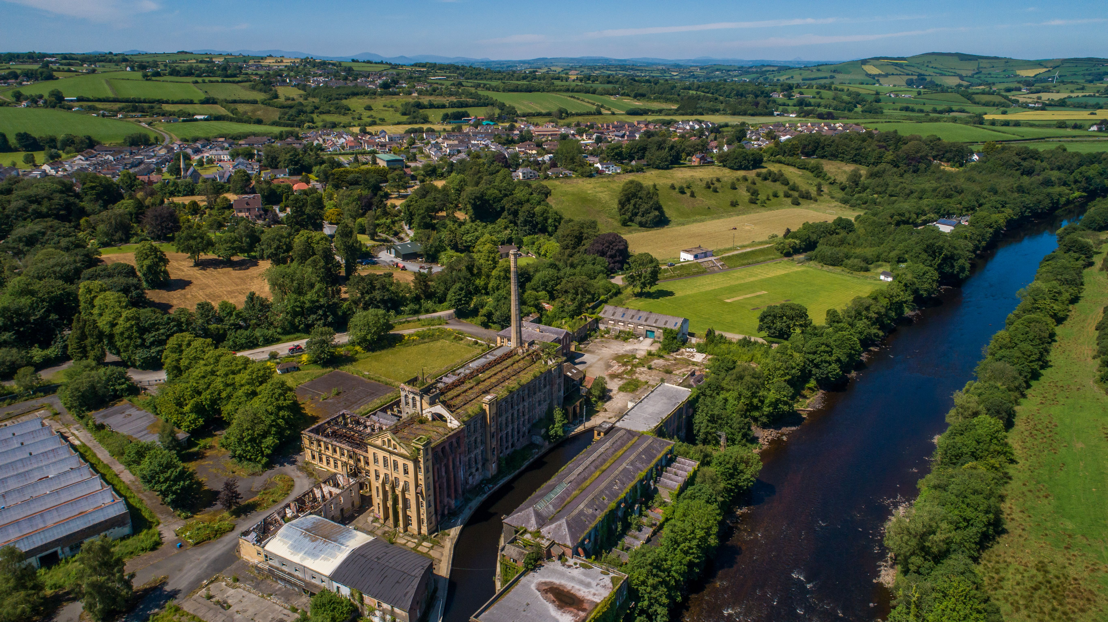
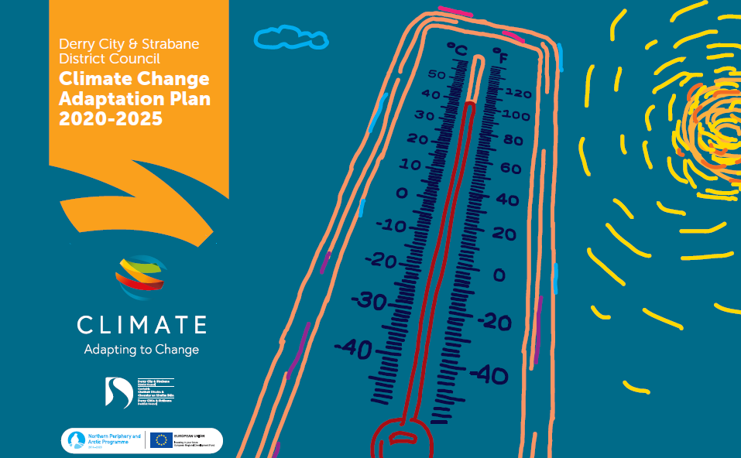
What does an adaptation plan look like?
Derry City and Strabane District Council
Vision
DCSDC is better prepared and more resilient to the effects of climate change creating a safe and sustainable region for all
Increase Capacity
Increase capacity to respond to climate change ensuring resilience of our services, people, operations, assets and estate to the impacts of climate change.
Raise Awareness
Raise awareness of the impacts of climate change across the City & District to deliver effective adaptation.
Lead by Example
Lead by example and work collaboratively to ensure resilience and deliver climate adaptation.
Aims

Slide 21
Themes & Priorities (DCSDC Plan)
Cross Cutting Themes
Ensure governance and resources of Derry City & Strabane District Council are adequate to deliver adaptation planning and actions, and work with others to strengthen the resilience of the North West region
Increase awareness and understanding of climate change contributing to the ability of Council and communities to adapt
Ensure an evidenced understanding of climate change impacts and adaptation options
Functional Themes
Mainstream climate adaptation into policies and plans and prepare Council staff for the effects of climate change
Prepare for and address the impacts of climate change ensuring protection of Council assets, property and infrastructure
Ensure continued service delivery and maintain Council operations and resilience to climate change
Ensure future developments, planning policy and decisions prepare for the effects of climate change
Prioritise Green Infrastructure for climate adaptation within Council estates
Identify and address the impacts, risks and opportunities of climate change to local heritage assets, collections, cultural programs, festivals and events

Slide 22
Organisational adaptation planning actions fall broadly into two categories:
Practical Actions (example):
Objective | Action | Timescale | Responsibility
Improve understanding of the impacts and costs of severe weather events by collecting, updating, synthesising and sharing information | Develop intelligent information management systems including reporting mechanism to record damages, increased staffing and resource costs associated with severe weather events and gradual change. | 3 years | Lead Department and relevant services/external bodies
Increase understanding of risk to assets and estates | Undertake audit of property & assets – assess risk from flooding, heat, storms | 1 year | Property and Fleet Managers
Ensure Council capital development and regeneration projects respond and adapt to climate change | Undertake climate risk and opportunities assessment for all council projects | Ongoing | Capital Development
Capacity / Governance Actions (example)
Enhance ability to respond through increased awareness and knowledge | Provide climate change training to parks employees and volunteers: how is my service at risks from climate change and how can this be addressed? | 1-2 years | Lead Department and relevant services/external bodies
 | Provide climate change training and engage with elected members | 1-2 years | Lead Department and relevant services/external bodies

Slide 23
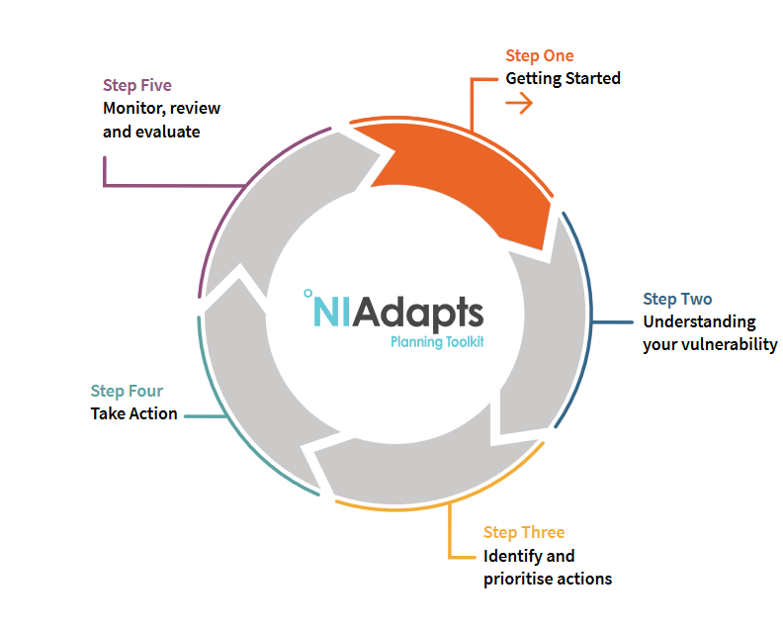
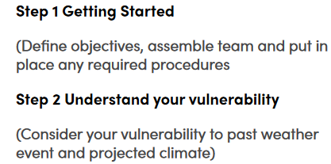
The Five Steps to creating an Adaptation Plan…
Today’s meeting is covering elements of Step 1 and Step 2…

Slide 24
The Five Steps to creating an Adaptation Plan…
The Next Steps will be:
Step 3 – Identify and Prioritise Actions (2 further workshops)
Develop Climate Risk Register (based on information gathered during today’s session)
Create Vision and Objectives
Co-create action plan with all services
Ratify
Step 4 – Take Action
Implement the Plan, with heads of service taking responsibility for their key areas.
Step 5 – Monitor, Review and Evaluate
Agree a review process, monitored at intervals by regular working group meetings.

Slide 25
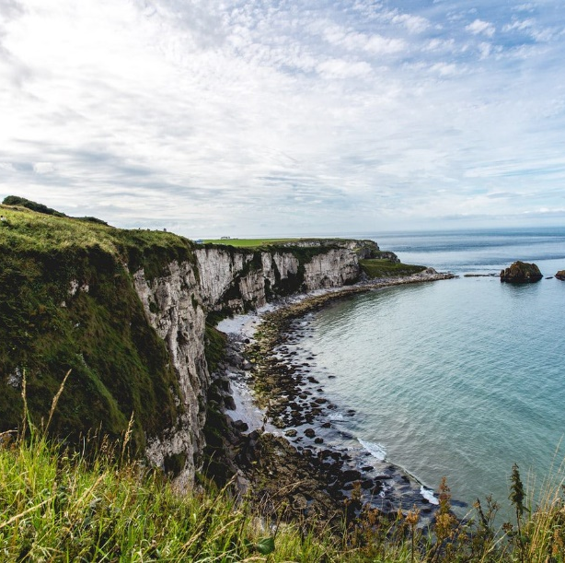
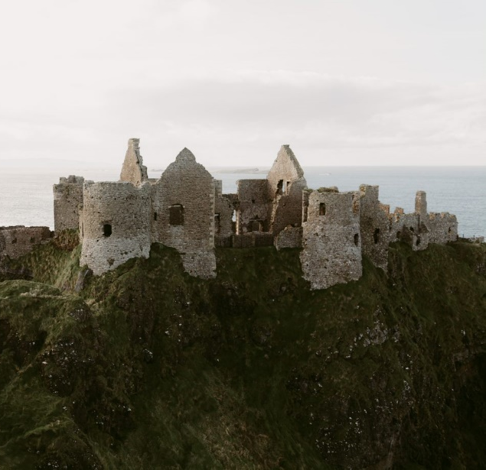
The Decision-making Environment after COVID
Barriers to Response:
Furlough, Remote Working, Interruption to Decision-making, Resource Constraints
Adaptation Planning must be as efficient as possible
What are we building on?
Increased value of nature
Organisations can move at pace and scale when required
Community Resilience, partnership, volunteering
Uncertainty in longer supply chains
Attention drawn to existing social inequalities
Co-operation and risk management roles of central and local government
Renewed public appreciation of scientific expertise
Green Recovery
“Let’s take the opportunity to re-imagine our society and make the change for a happier, healthier future for all citizens.”

Slide 26
Terms of Reference

Slide 27
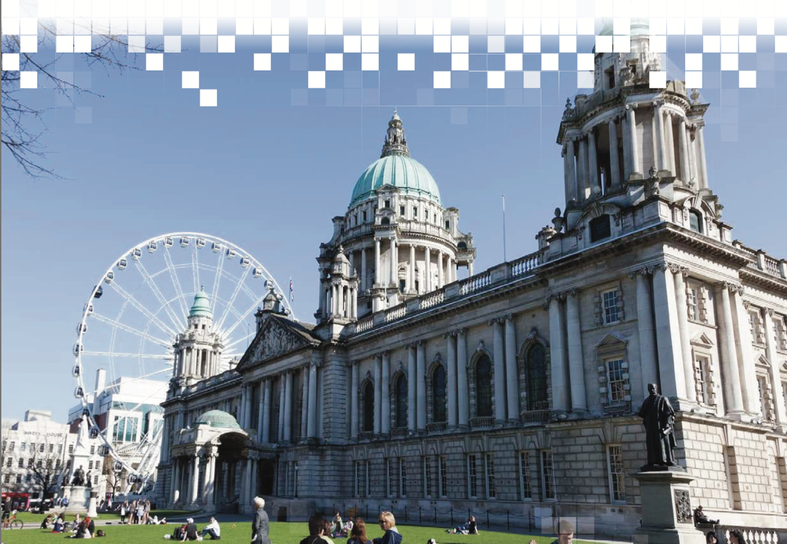
What is Your Role?
A member of a dedicated climate working group, giving your time to undertake ‘adaptation planning.’
Help gather representation from all services, using local insight and knowledge, and actively participating in the group.
Act as a central point of information and action –
Approaching other staff to gather information for the group,
Working with colleagues and senior staff to develop actions for the plan, and
Acting as an ‘adaptation champion’ in your service area/department.

Slide 28
Terms of Reference
The Local Government Climate Action Network (LGCAN) aims to support councils to deliver the following action from the NI Climate Change Adaptation Programme as agreed by SOLACE: “Work with councils to embed the adaptation planning cycle across local council planning with the aim of encouraging councils to complete a minimum of Step 1 by 2021 and Step 4 by 2024”.
Your Organisation Climate Adaptation Sub-group aims to:
Develop an engaged partnership to guide, create and implement a climate adaptation plan for council, and communicate progress with colleagues.
Provide a platform for knowledge and expertise from colleagues to be applied to climate adaptation,
Support the 'adaptation lead’; including provision of resource, information and guidance,
Engage colleagues and wider stakeholders to advise on development and adoption of actions for each service,
Review and finalise Adaptation Plan,
Take responsibility for adaptation plan implementation, monitoring and updates.
Time Requirement:
Meetings once a quarter, or as defined by the adaptation lead
Regular communication with individual teams for buy-in, information sharing and gathering ideas for actions

Slide 29
Responsibility:
Working Group Members
Attend meetings and engage wherever possible to allow for a vibrant exchange of ideas
Help to guide timeframe, vision and scope of the plan, including how it aligns with other council work
Support the adaptation lead wherever possible, including communicating with your own service colleagues and contributing actions.
Help to develop senior buy-in where possible
Lead adaptation contacts
Participate in multi-council LGCAN training meetings
Organise logistics and secretariat for internal working group meetings
Coordinate work between meetings
Liaise with all other council groupings as necessary
CNI
Provide training and support for council working group, adaptation lead and elected members
Provide a suite of guidance to follow

Slide 30
Adaptation Scoping Exercise

Slide 31
The aim is to find your Major Alignments and Opportunities, e.g.…
Corporate Plan (under development)
Local Development Plan
Community Planning
Major Central Government Project
COVID Recovery
Major Initiatives
External Priorities
Opportunities for Development
Barriers
Biodiversity Plan (under development)
Additional Policies and Initiatives
New Council Office Masterplan – not climate proofed
Corporate Risk Register
Asset Management Strategy (under development)
Procurement
Green and Blue Infrastructure Plan (under development)
Emergency Plans

Slide 32
Next Step –
Workshop 1: Understanding Your Vulnerability

Slide 33
DCSDC Key Services
Finance
Risk Management
Planning
Economic Development
Emergency Planning
Property & Asset Management
Capital Development
Streetscape
HR/ Health & Safety
Environmental Health
Communities
Regeneration
Tourism
Culture
Waste Management
Parks/Green Infrastructure/Grounds Management
Heritage
Marketing
Energy
ICT
Who should be involved in your council?

Slide 34
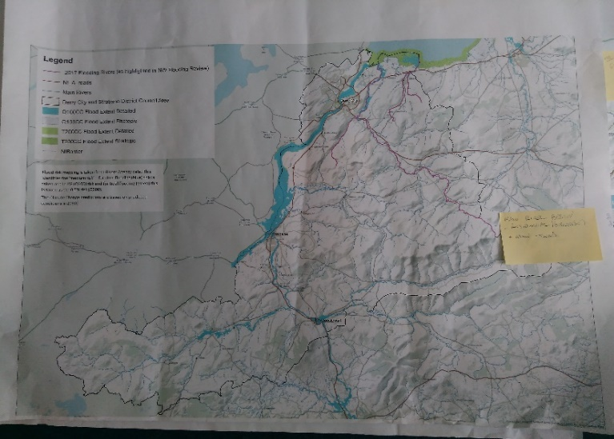
Vulnerability Assessment (Workshop 1) Methodology
Step 2 – Understanding Your Vulnerability
Undertake a qualitative assessment; utilising local knowledge to understand council vulnerability to past and future climate impacts.
Using Spatial Maps showing BCC Assets, participants undertake the following:
Group Exercise 1a&b - Understanding your Current and Future Risk
Group Exercise 2 – What current work already addresses climate risks?

Slide 35
Ahead of Workshop 1…
Decide who will attend
Develop up GIS Maps as specified on NI Adapts website - Step 2.
Decide how many areas are to be mapped – consult with your GIS colleague.
Core Working Group to Volunteer to assist at Workshop 1, either as ‘Chair’ leading the conversation, or as a scribe.

